Slide 1
Plotting non-integer coordinates
Plotting coordinates

Slide 2
how to use Oak lessons

Slide 3
I can describe and plot coordinates, including non-integer values, in all four quadrants.

Slide 4
An integer is any positive or negative whole number or zero. E.g. -2, 0, 153 are all examples of integers.

Slide 5

Plotting non-integer coordinates
Coordinates with non-integer values
Shapes with non-integer value coordinates

Slide 6
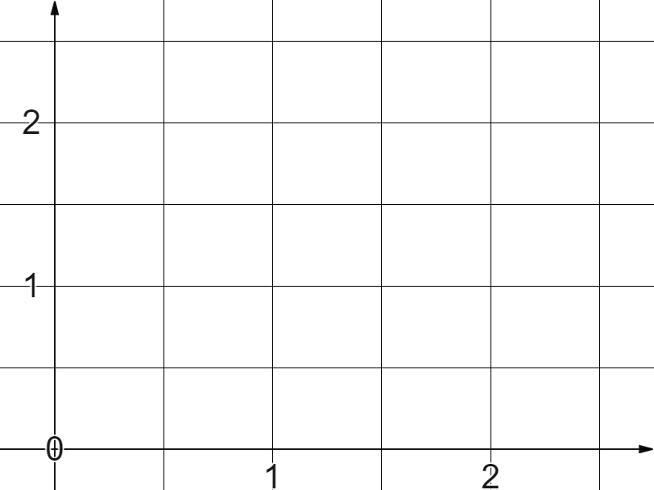
Coordinates with non-integer values
Is there a coordinate that exists between these four coordinates?
It would be halfway between 1 and 2 in the x direction,
(1, 2)
(2, 2)
✖
✖
and halfway between
1 and 2 in the y direction.
(1.5, 1.5)
✖
✖
✖
(1, 1)
(2, 1)
So it must be (1.5, 1.5)

Slide 7
Coordinates with non-integer values
Having an axes with gridlines between the integers helps us to plot non-integer coordinates.
✖
(0.5,2.5)
✖
(1.5,1.5)
Plot the coordinate (1.5,1.5) on these axes.
How about (0.5, 2.5)?

Slide 8

Coordinates with non-integer values
Which of these is the coordinate for the point shown on the graph?
(5,3)
✖
(2,1)
(2.5,1.5)

Slide 9
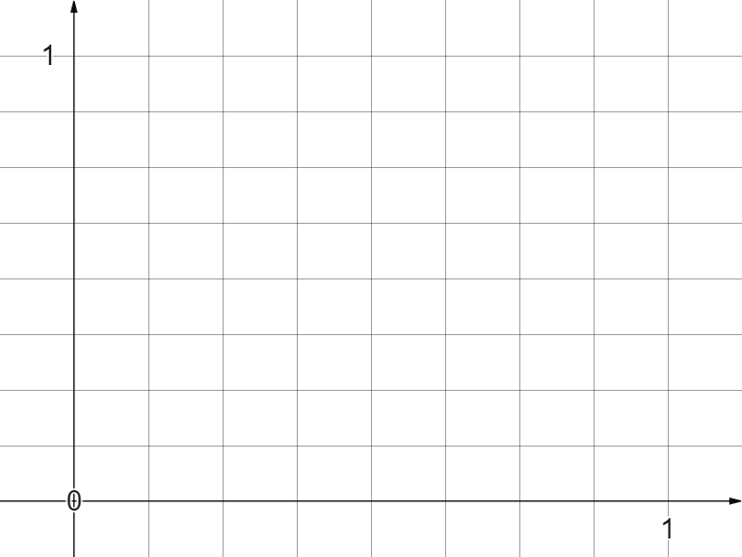
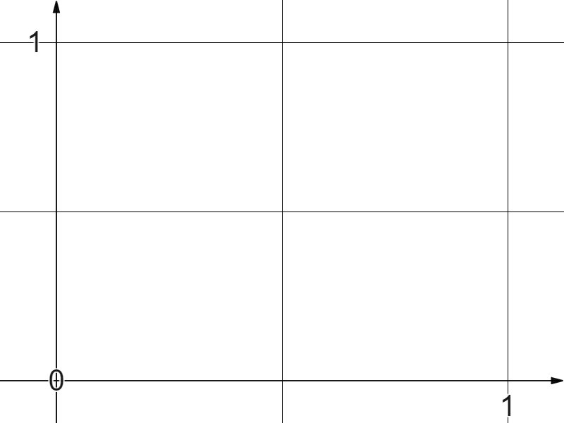

Coordinates with non-integer values
What are the blank labels on these axes?
0.75
What labels could we add now?
0.5
0.25
0.25
0.5
0.75

Slide 10
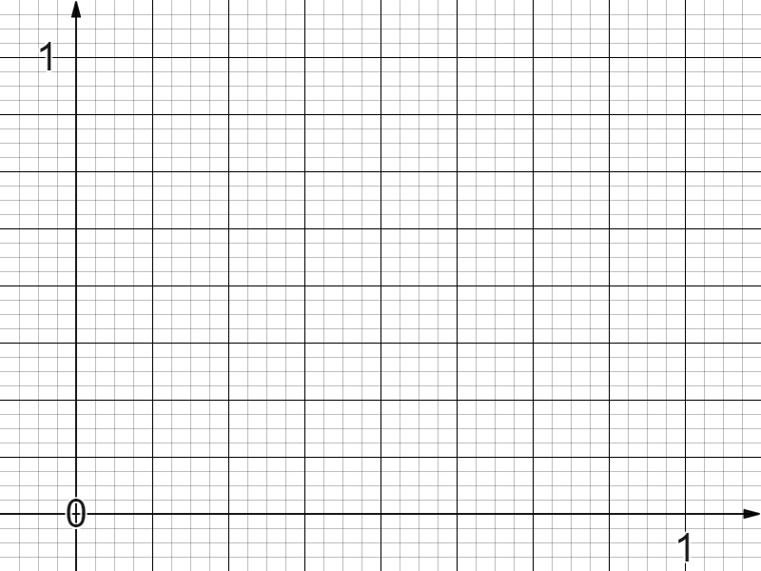
Coordinates with non-integer values
How far could this keep going?
0.75
Going to higher levels of precision here has really important uses for mathematics, science and many other subjects.
0.5
0.25
0.25
0.5
0.75

Slide 11
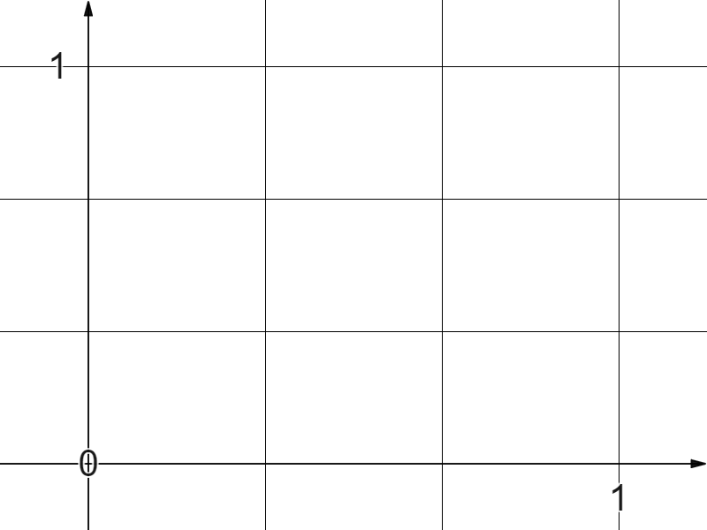
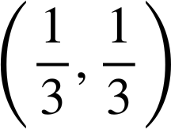
Coordinates with non-integer values
What is this coordinate?
We can express non-integer coordinates in fractional form.
✖

Slide 12
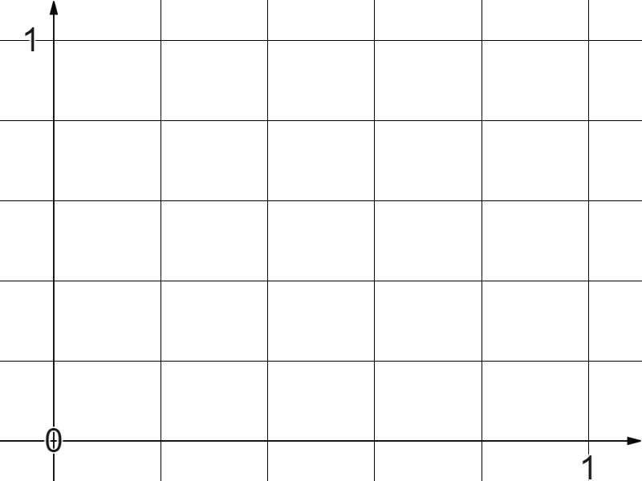
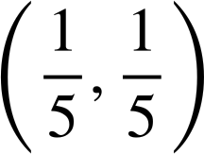
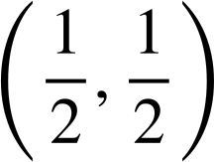
Coordinates with non-integer values
Which of these represent the coordinate shown on the graph?
(0.2,0.2)
✖

Slide 13
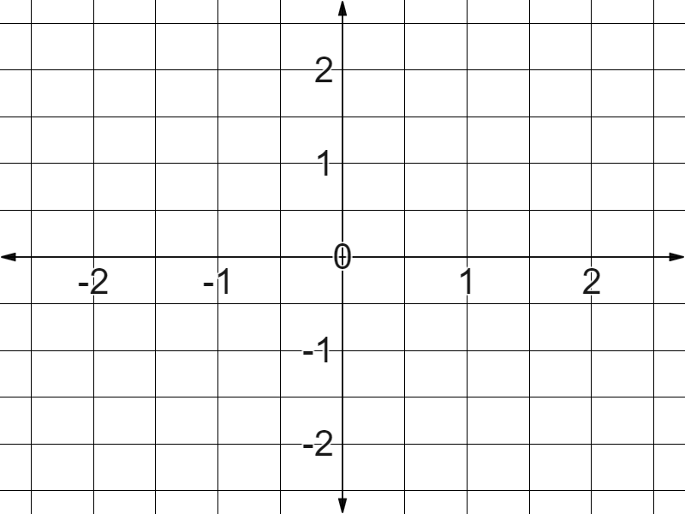
Coordinates with non-integer values
The coordinate (1.5,0.5)
What are the other three coordinates?
(-1.5,0.5)
(1.5,0.5)
✖
✖
Non-integer coordinates can be plotted in any quadrant.
✖
✖
(-1.5,-1.5)
(1.5,-1.5)

Slide 14
Coordinates with non-integer values
Which of these coordinates
is (-0.5,1.5)?
B
A
✖
B
✖
A
C
✖
C

Slide 15
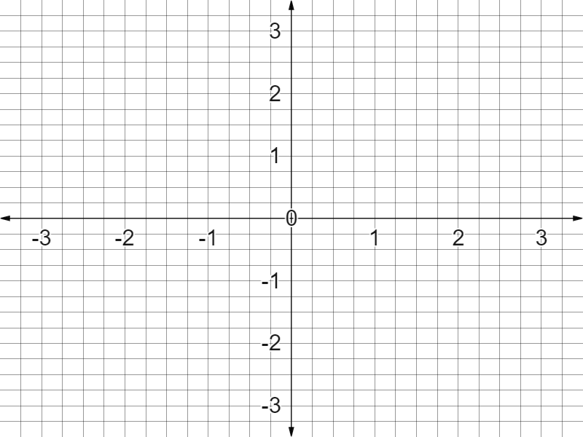

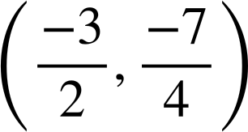
Coordinates with non-integer values
1) Plot the following coordinates:
A (0.5,-2.5)
B (-0.5,2.5)
C
(-2.25,
)
D

Slide 16
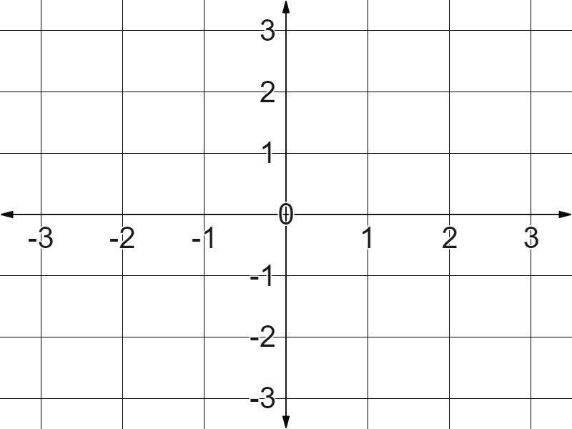
Coordinates with non-integer values
2) Match the coordinates to the points on the graph:
✖
✖
✖
✖
A (1.8,2.2)
B (2.1,1.7)
C (-2.1,1.6)
D (-1.6,1.6)
E (1.6,-1.6)
✖

Slide 17
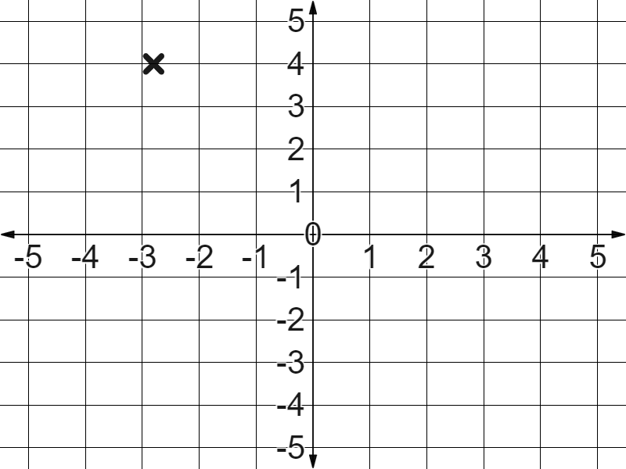
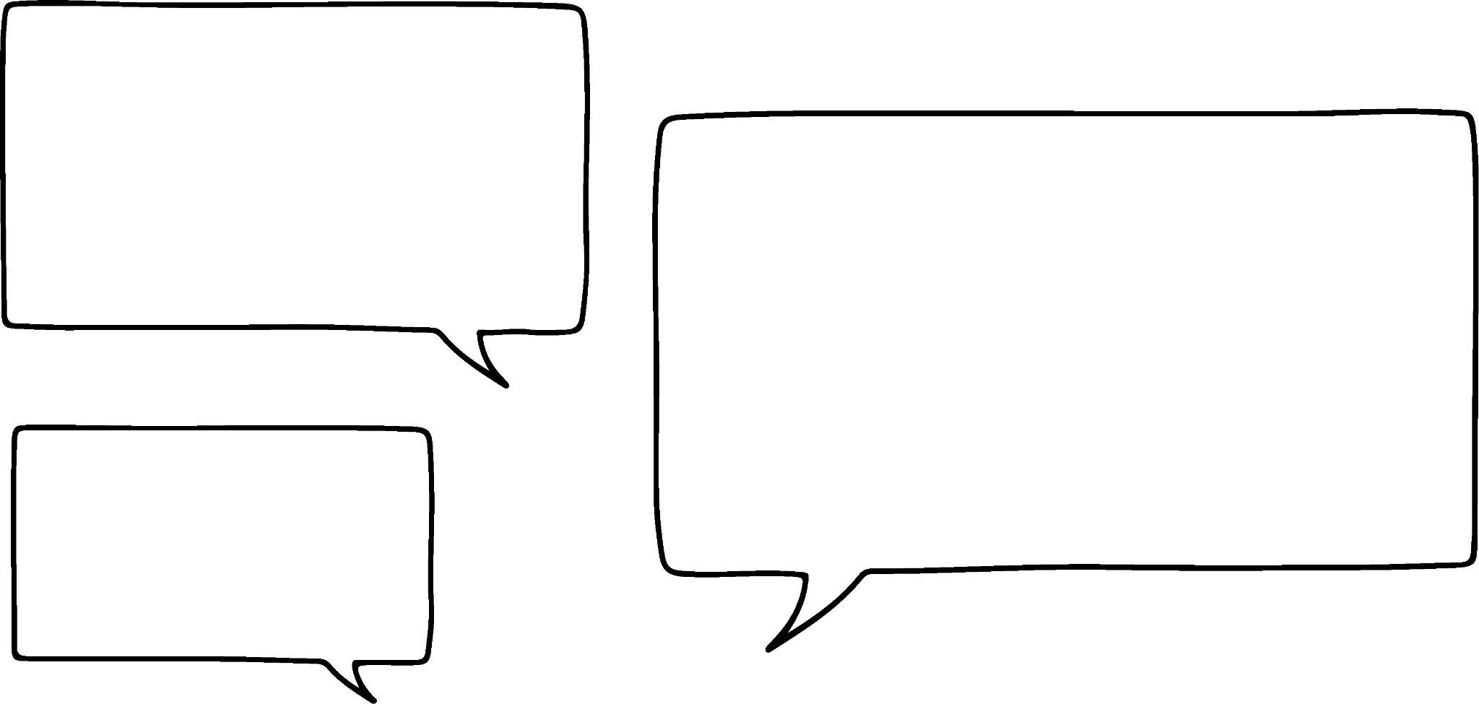

Coordinates with non-integer values
3) Jun says this.
The point is just past -3 so this is probably (-3.1,4)
Write a sentence justifying why Jun is wrong.

Slide 18
Coordinates with non-integer values
1) Plot the following coordinates:
B
✖
A (0.5,-2.5)
C
✖
B (-0.5,2.5)
C
(-2.25,
)
D
✖
D
✖
A

Slide 19
Coordinates with non-integer values
2) Match the coordinates to the points on the graph:
A
✖
C
D
✖
B
A (1.8,2.2)
B (2.1,1.7)
C (-2.1,1.6)
D (-1.6,1.6)
E (1.6,-1.6)
✖
✖
✖
E

Slide 20
Coordinates with non-integer values
3) Jun says this.
The point is just past -3 so this is probably (-3.1,4)
From the direction of the origin the coordinate is still approaching -3 so it is more likely to approximate as (-2.9,4).

Slide 21
Plotting non-integer coordinates
Coordinates with non-integer values
Shapes with non-integer value coordinates

Slide 22
Shapes with non-integer value coordinates
Plot the below coordinates.
(-0.5,0.5)
(-0.5,-1.5)
(2,-1.5)
(2,0.5)
✖
✖
✖
✖
What do you notice?
They form a rectangle.

Slide 23
Shapes with non-integer value coordinates
Plot the below coordinates.
(-0.5,0.5)
(-0.5,-1.5)
(2,-1.5)
(2,0.5)
✖
✖
Can you see the moments where the x and y coordinates match?
✖
✖

Slide 24
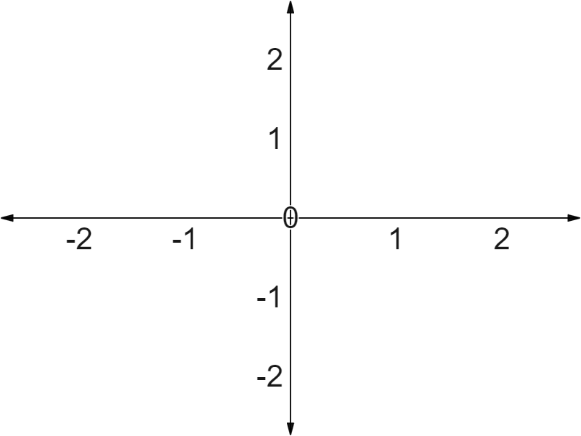
Shapes with non-integer value coordinates
If the rectangle’s sides are parallel to the x and y axes we don’t even need the gridlines.
(-1.1, ? )
(1.5,0.8)
✖
✖
What do we already know about this y coordinate?
✖
✖
It is 0.8 in the y direction.

Slide 25
Shapes with non-integer value coordinates
What do we already know about this x coordinate?
(-1.1,0.8)
(1.5,0.8)
It is -1.1 in the x direction.
✖
✖
What do we know about the final coordinate?
✖
✖
✖
-1.1
(1.5,-0.9)
( , -0.9)
-0.9 in the y direction.

Slide 26
Shapes with non-integer value coordinates
What is the fourth coordinate of this square?
(-1.5,-0.5)
(-1.5,0.5)
(0,0.5)
✖
✖
(-0.5,-1.5)
✖
✖
(-1.5,-1)
(0,-1)

Slide 27
Shapes with non-integer value coordinates
What is the fourth coordinate of this rectangle?
(-1.8,1.3)
(0.95,1.3)
(0.95,-0.2)
✖
✖
(0.95,-1.3)
✖
✖
(-1.8,-0.2)
(-0.95,1.3)

Slide 28
Shapes with non-integer value coordinates
These four squares sit between the origin and coordinate (1.5,1.5).
✖
What is this coordinate?
(1.5,1.5)
It’s half the journey in both directions.
?
(0.75,0.75)
✖
1.5 ÷ 2 = 0.75
(0.75, 0.75)

Slide 29
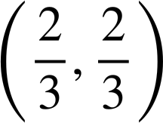

Shapes with non-integer value coordinates
These nine squares sit between the origin and coordinate (2,2).
✖
(2,2)
How do you find the coordinate for A?
A
It is one third of the journey to two in both directions!
✖
2 ÷ 3 =

Slide 30
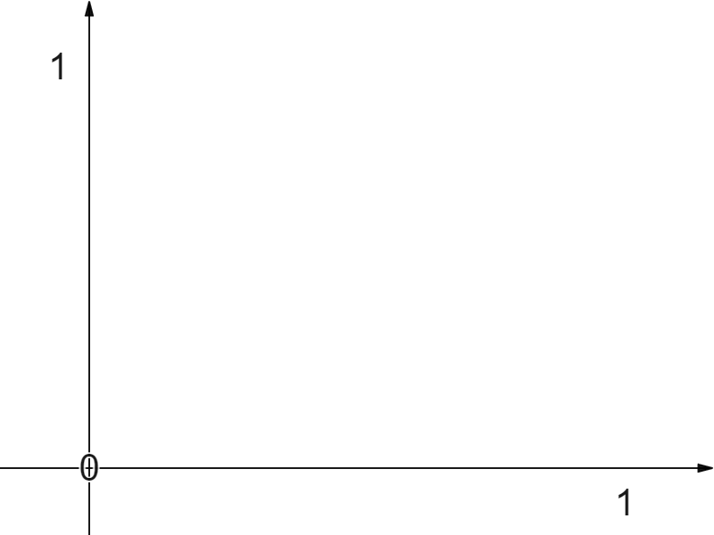
Shapes with non-integer value coordinates
What is the coordinate of point A?
Leave your answer in decimal form.
(0.1,0.1)
✖
(1,1)
(0.25,0.25)
✖
(1,1)
A

Slide 31
Shapes with non-integer value coordinates
What is the coordinate of B?
Leave your answer in decimal form.
(1,3)
✖
(1,1)
✖
B
(0.25,0.75)
✖
(0.75,0.75)
(0.25,0.25)

Slide 32
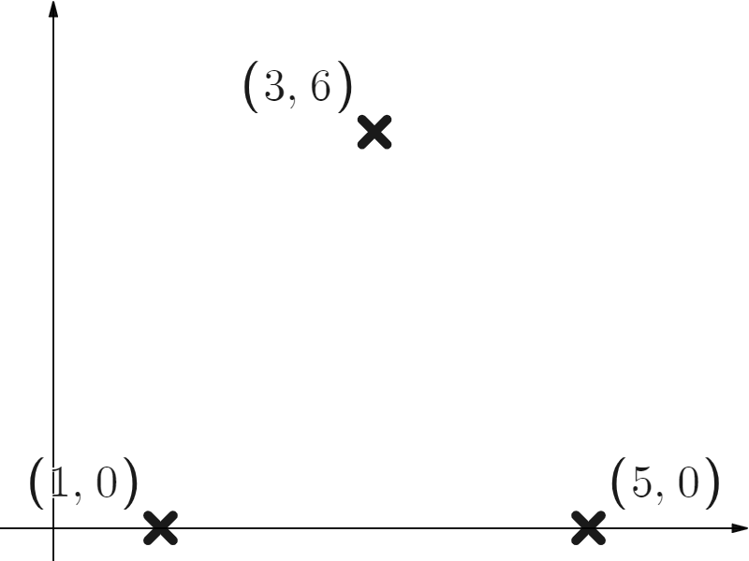

Shapes with non-integer value coordinates
These three coordinates form an isosceles triangle.
Find the missing x coordinate.
You might think of it as half the leap from 1 to 5 therefore 3.

Slide 33
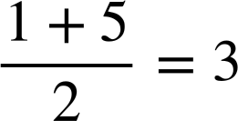
Shapes with non-integer value coordinates
These three coordinates form an isosceles triangle.
Find the missing x coordinate.
You might think of it as the midpoint of 1 and 5

Slide 34
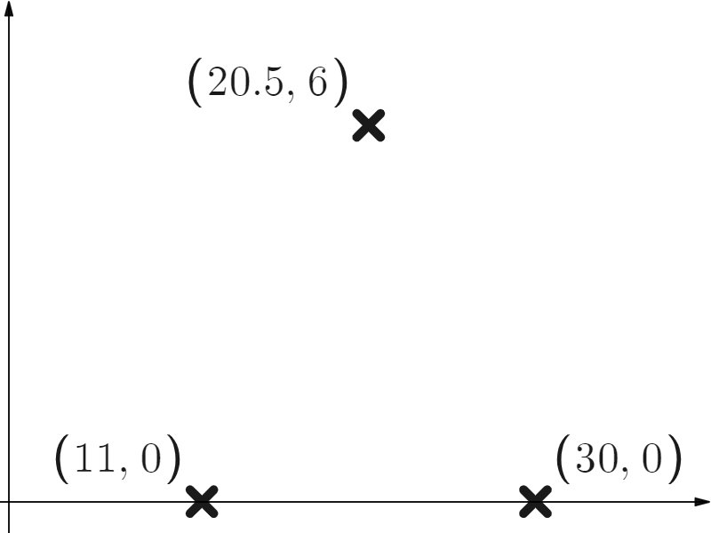
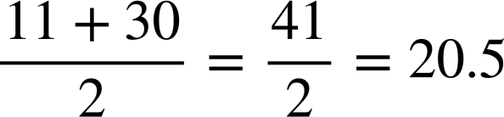
Shapes with non-integer value coordinates
These three coordinates form an isosceles triangle.
Find the missing x coordinate.

Slide 35
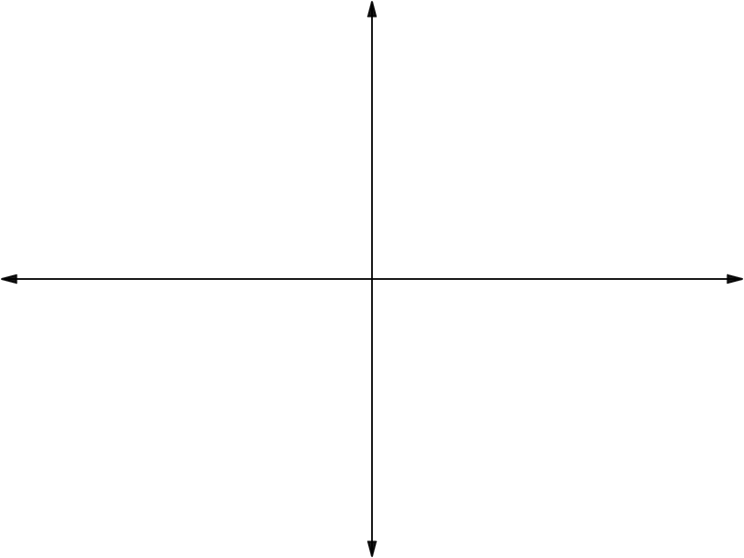
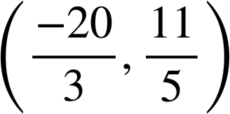
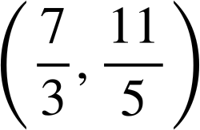
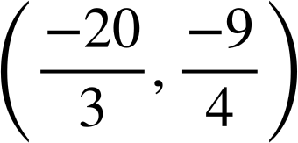
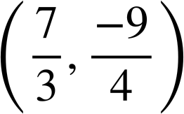
Shapes with non-integer value coordinates
1) Find the missing coordinates of these rectangles.
(-1.1,0.9)
(0.4,0.9)
✖
✖
✖
✖
✖
✖
(-1.1,-2.3)
(0.4,-2.3)
✖
✖

Slide 36
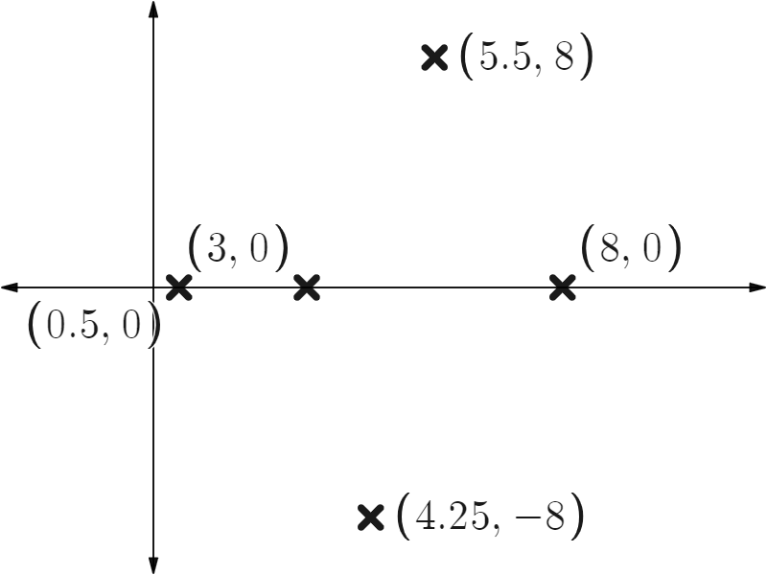
Shapes with non-integer value coordinates
2) Find the missing x coordinate values in these isosceles triangles.

Slide 37
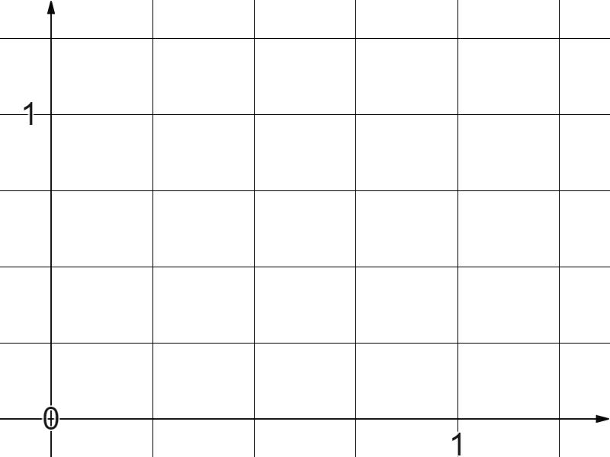
Shapes with non-integer value coordinates
3) These four equally sized squares sit between the origin and coordinate (1,1).
✖
(1,1)
Find coordinates A and B.
✖
B
A
✖

Slide 38
Shapes with non-integer value coordinates
1) Find the missing coordinates of these rectangles.
(-1.1,0.9)
(0.4,0.9)
✖
✖
✖
✖
✖
✖
(-1.1,-2.3)
(0.4,-2.3)
✖
✖

Slide 39
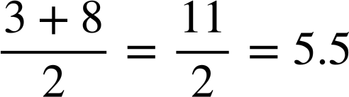
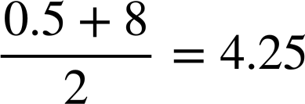
Shapes with non-integer value coordinates
2) Find the missing x coordinate values in these isosceles triangles.

Slide 40

Shapes with non-integer value coordinates
3) These four equally sized squares sit between the origin and coordinate (1,1).
✖
(1,1)
Find coordinates A and B.
✖
B
A
✖
Coordinate A (0.25,0.5)
✖
(0.25,0.25)

Slide 41
Shapes with non-integer value coordinates
3) These four equally sized squares sit between the origin and coordinate (1,1).
✖
(1,1)
Find coordinates A and B.
✖
B
A
✖
Coordinate A (0.25,0.5)
✖
(0.25,0.25)
Coordinate B (0.75,0.75)

Slide 42
Plotting non-integer coordinates
Coordinates can be read and plotted using integers, fractions or decimals.
Reading the scales on the axes is especially important when dealing with non-integer coordinates.
This is especially useful for solving geometry problems on coordinate grids.

Slide 43

© Oak National Academy 2023.
Produced in partnership with Mathematics in Education and Industry.
Licensed on the Open Government Licence v3.0, except where otherwise stated. See Oak terms and conditions.

